Slide 1
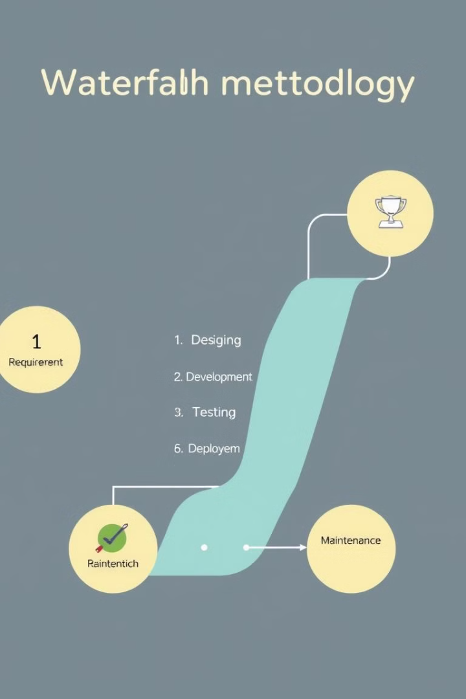
Mastering Waterfall
A structured guide to understanding and implementing the Waterfall methodology for project success.
Overview of the Waterfall Methodology
Actionable insights
Real-world examples

Slide 2
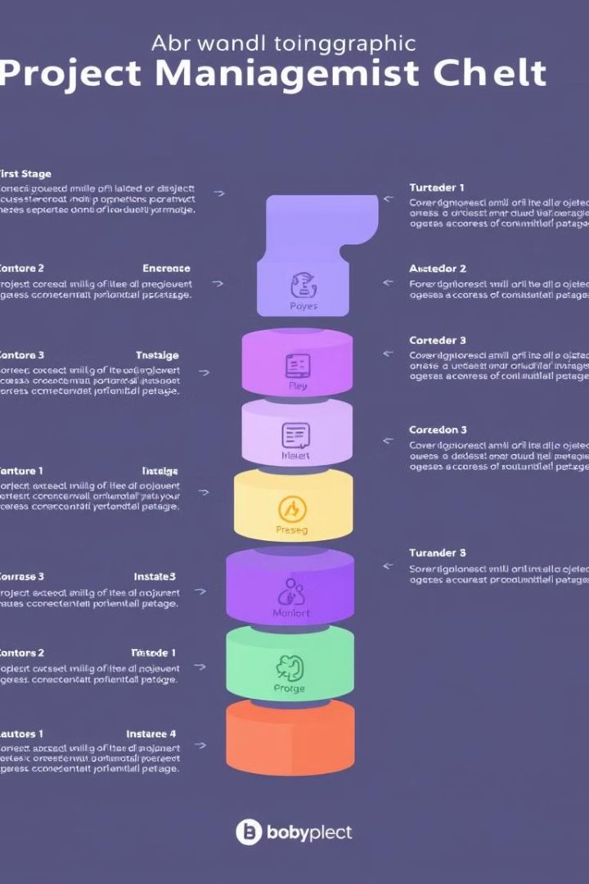
Demystifying Waterfall: A Practical Guide for Project Success
This presentation provides a practical guide to the Waterfall methodology, offering actionable insights and real-world examples. Learn how to keep your projects on track and within budget using this structured approach.

Slide 3
What is the Waterfall Methodology?
Definition
Key Characteristics
The Waterfall methodology is a sequential, linear approach to project management, where each phase must be completed before the next one begins.
Sequential Phases: A rigid structure where each phase (requirements, design, implementation, testing, deployment, maintenance) is completed in order.
Phase Completion: Each phase is fully completed and reviewed before moving on to the next, with formal sign-off processes.
Emphasis on Planning: Heavy emphasis is placed on detailed planning and documentation upfront, aiming to define requirements and scope comprehensively from the outset.
Limited Iteration: Minimal or no iteration between phases; changes are costly and difficult to implement once a phase is completed.

Slide 4

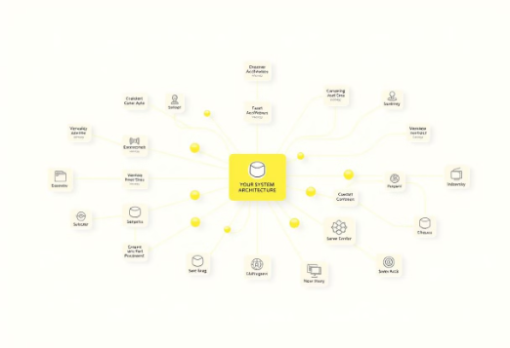

The Six Phases of Waterfall
Requirements
Design
Implementation
Defining project goals. Gathering detailed requirements from stakeholders.
Creating the system architecture and specifications. Developing design documents.
Building and integrating the system components. Closely following design specifications.

Slide 5



Waterfall Phases Continued
Testing
Deployment
Maintenance
Ensuring the system meets specified requirements and functions as expected.
Making the system available to end-users in its intended environment.
Providing ongoing support, bug fixes, and updates to the deployed system.

Slide 6


Final Waterfall Phases
Deployment
Maintenance
Releasing the system to users. Installing and configuring settings.
Ongoing support and updates. Fixing defects and providing user support.

Slide 7
Real-World Case Study: XYZ Bank's Online Banking System
Requirements Gathering
XYZ Bank conducted extensive interviews with customers, compliance officers, and security experts to define a comprehensive set of requirements for their new online banking platform. Key requirements included secure authentication, end-to-end data encryption, and strict adherence to banking regulations.
Implementation
Maintenance
XYZ Bank's developers followed strict coding standards and secure software development practices to implement the online banking system. All code was thoroughly reviewed, and security testing was conducted at every stage to identify and mitigate vulnerabilities.
XYZ Bank established a dedicated security operations center to monitor the online banking system for threats and vulnerabilities. The bank also implemented a robust patch management process to ensure the system remained up-to-date and secure, with regular security audits and compliance checks.
1
2
3
4
5
System Design
Testing
The bank's IT team collaborated with security architects to design a robust, layered security framework. This included multi-factor authentication, biometric identification, and advanced encryption protocols. The system was also designed to generate detailed audit logs to ensure regulatory compliance.
The bank's quality assurance team designed a comprehensive test plan to validate the security, reliability, and compliance of the online banking system. This included penetration testing, stress testing, and end-to-end user acceptance testing to ensure the platform met all requirements.

Slide 8
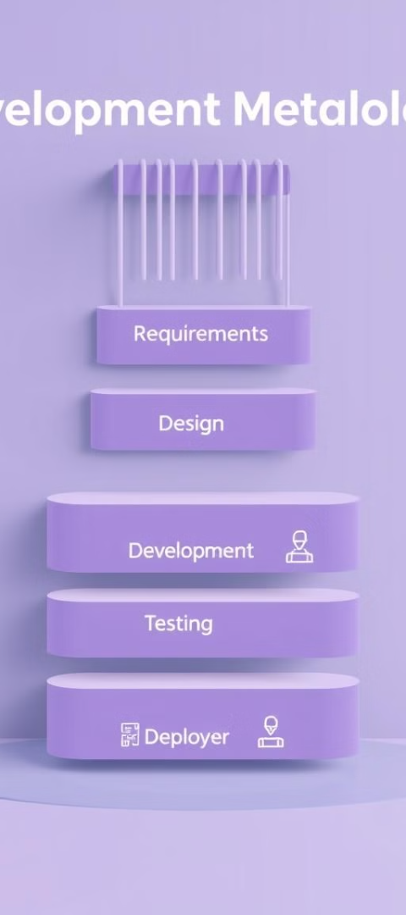




Advantages of the Waterfall Methodology
Simplicity
Structure
Documentation
Easy to understand and implement.
Provides clear milestones and deliverables.
Enforces documentation.
Control
Strong control over scope and schedule.

Slide 9
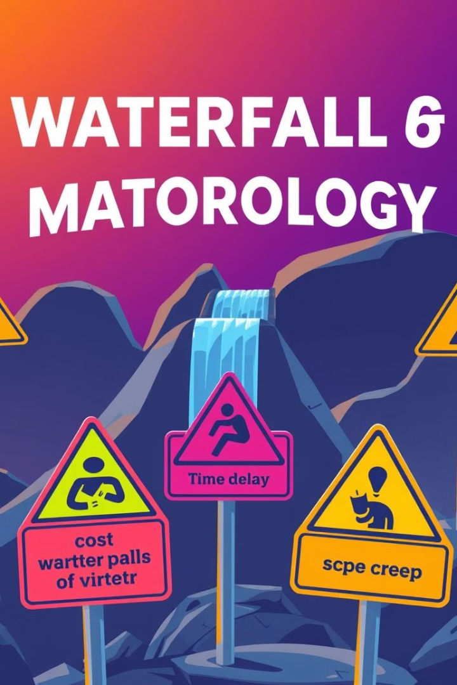
Disadvantages of the Waterfall Methodology
Inflexibility
Difficult to accommodate changes.
Risk
High risk of not meeting needs.
Time
Can be time-consuming.
Feedback
Limited user feedback.

Slide 10




Best Practices for Implementing Waterfall
Detailed Requirements Gathering: Invest in understanding requirements.
Thorough Planning: Create a project plan with timelines.
Risk Management: Identify and mitigate potential risks early.

Slide 11




Presenters
Bob Kanyi
Moses Mwai
Tyrese Muigai
Geoffrey Chege
SCT211-0012/2022
SCT211-0029/2022
SCT211-0457/2022
SCT211-0002/2019

Slide 12

Conclusion: Is Waterfall Right for Your Project?
Waterfall is best for projects with well-defined needs and a stable scope.
Understand the advantages and disadvantages. Implement best practices.
Q&A: Open the floor for questions.

